Slide 1
Wildfire Preparedness: Artificial Intelligence and Modeling in Wildfire Evacuation Planning
American Planning Association State Conference
September 30, 2024

Slide 2
Panelists
Darin Neufeld, AICP
Harris & Associates, Director
Andrew Scher, EIT
Fehr & Peers, Transportation Engineer
Bowen Kyle
Ladris,
Chief Technology Officer

Slide 3
Table of Contents
Background on Safety Elements and Evacuation Planning
Dynamic Traffic Assignment: Evacuations and Extreme Events
Artificial Intelligence and Modeling in Wildfire Evacuation Planning
Questions and Answers

Slide 4
WHAT IS A SAFETY ELEMENT?
The Safety Element is a required general plan element that assesses hazard risk and defines objectives and policies to:
Protect the health, safety, and welfare of the community
Address public safety hazards, including climate change
Build resilience, preparedness, and responsiveness to hazards
Notes:
The Safety Element is important for reducing the potential risk of death, injuries, property damage, and economic and social dislocation resulting from hazards such as fires, floods, droughts, earthquakes, landslides, climate change, and other hazards. OPR guidance indicates that the safety element should contain hazard and risk reduction strategies and state law encourages jurisdictions to incorporate by reference into the safety element.

Slide 5
EMERGENCY EVACUATION ROUTE
ANALYSIS REQUIREMENTS
AB 747
Requires local governments to identify evacuation routes and evaluate their capacity, safety, and viability under a range of emergency scenarios.
SB 99
Requires local governments to identify residential developments in hazard areas that do not have at least two emergency evacuation routes.
AB 1409
Requires local governments to identify evacuation locations.
Select Emergency Scenarios
Define Evacuation Routes
Identify Evacuation Locations
Notes:
AB 747 (2019) requires cities and counties to update the Safety Element of their General Plans to identify evacuation routes and assess the capacity, safety, and viability of those routes under a range of emergency scenarios.
SB 99 (2019) requires cities and counties to identify residential developments in hazard areas that do not have at least two emergency evacuation routes (i.e., neighborhoods or households in a hazard area that have limited accessibility).
AB 1409 (2021) requires cities and counties to identify evacuation locations.

Slide 6
Office of Planning and Research: Evacuation Planning Technical Advisory
General Plan Evacuation Requirements
General Plan Evacuation Planning Guidance
Engage Early and Often
Plan for a Range of Hazards
Identify Residential Developments with Limited Evacuation Route Access
Identify Applicable Emergency Scenarios
Assess Evacuation Locations
Assess the Capacity, Safety, and Viability of Evacuation Routes
Identify Evacuation Routes and Locations
Example General Plan Policies and Programs
https://opr.ca.gov/docs/20220817-Fire_Hazard_Planning_TA.pdf
Notes:
Released April 2023 for public review and comment.
To analyze route viability, can use these approaches or a combination thereof:
Time-based Assessments
Distance-based Assessments
Population-based Assessments
Identify Evacuation Routes and Locations
Dynamic Identification Systems (ArcGIS or Zonehaven
Direct-based Identification
Hazard-based Identification

Slide 7
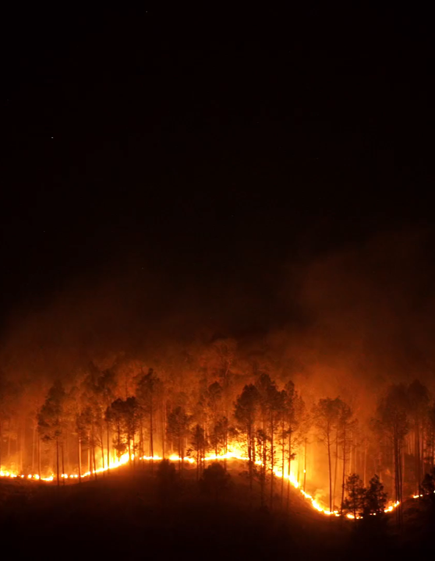
DYNAMIC TRAFFIC ASSIGNMENT:
EVACUATIONS AND EXTREME EVENTS
Presented by Andrew Scher

Slide 8
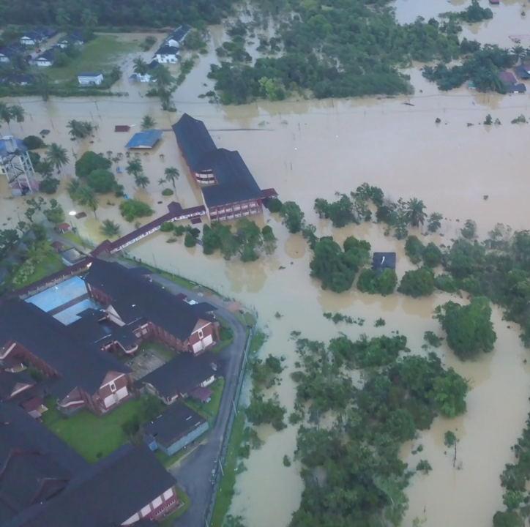
AGENDA
Resiliency and Accessibility
Capacity Assessment
Evac +
Analyzing Results

Slide 9
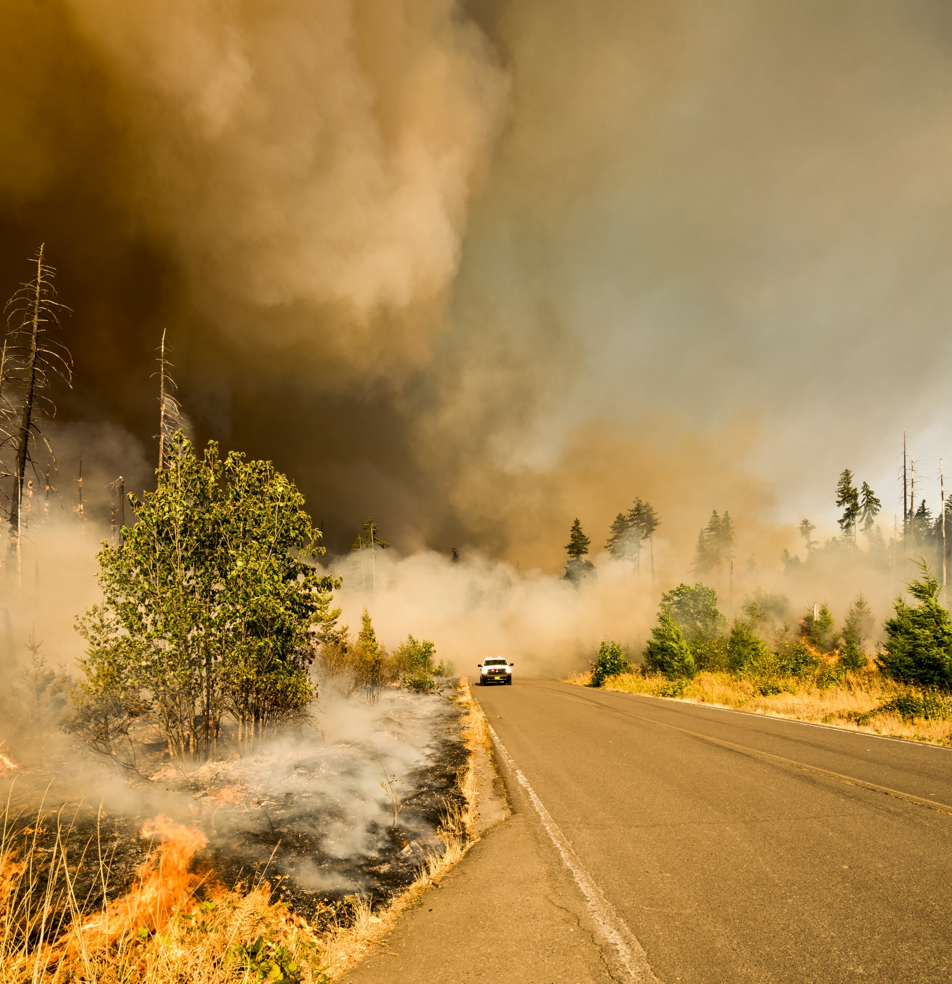
Types of Analysis
Resiliency Assessment: How many access routes are available for an evacuation
Capacity Assessment: How efficient is the transportation network during an evacuation
Notes:
Understanding hazards should influence long range planning decisions and funding decisions. On a macro scale, we've been working on projects to inform the question of network resilience, community access, and evacuation capacity

Slide 10
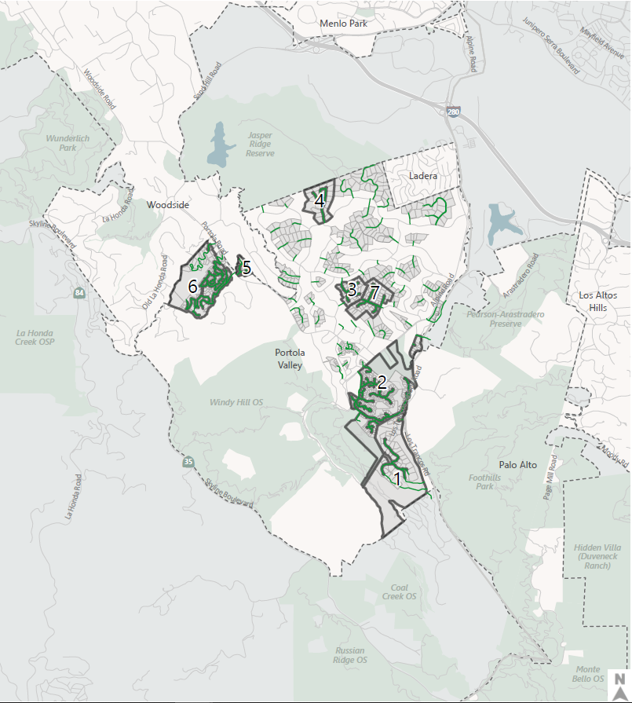
Resiliency
SB 99 Requires us to identify parcels and communities with only one point of access
Portola Valley Wildfire Traffic Evacuation Capacity Study shows parcels and groups of parcels served by a single primary access route
Notes:
Here’s a project example from a community in northern California, where we first started by identifying constrained streets, where only one access/ingress route is available

Slide 11
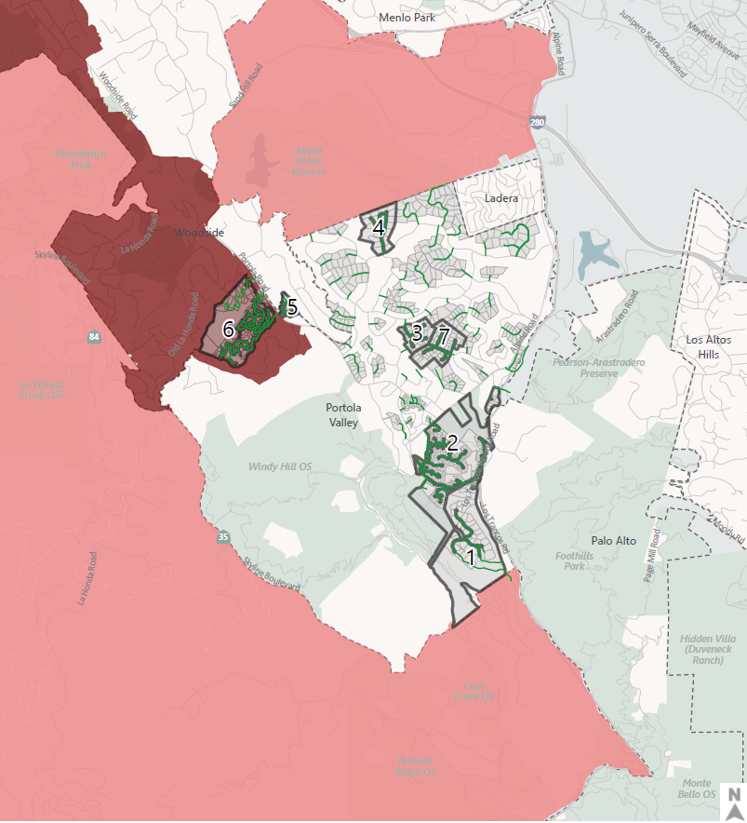
Resiliency
Portola Valley Wildfire Traffic Evacuation Capacity Study shows how hazards overlap with constrained parcel groups and streets
Identify available routes for neighborhoods
Distance neighborhoods must travel to get out of the City or get to shelters
Identify neighborhoods which may lose access to evacuation routes during a major flood event
Notes:
We then overlaid this analysis with the hazard layer for wildfires, which are split into local and state responsibility areas. This helped focus the remainder of the analysis on the neighborhoods where the constrained access conditions was producing the most risk and exposure.
We’ve also taken this one step further, to see what happens when an emergency event or hazard, such as a flood, interrupts the network and makes it impassable? How does neighborhood access change within the City or outside it?
Starting with the baseline, you can see how neighborhoods can access “external gateways” – or ways out of the county (whether for an evacuation or not)

Slide 12
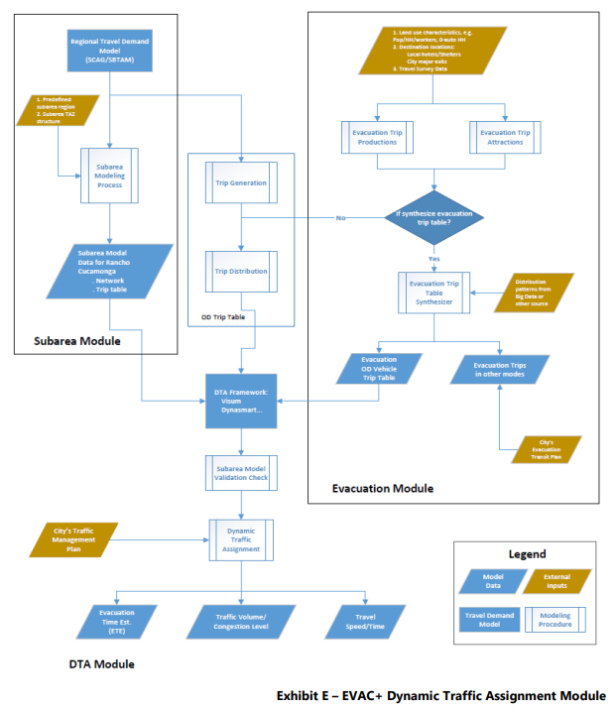
Capacity Assessment
AB 747 Requires us to evaluate the capacity of the evacuation system
Notes:
We then overlaid this analysis with the hazard layer for wildfires, which are split into local and state responsibility areas. This helped focus the remainder of the analysis on the neighborhoods where the constrained access conditions was producing the most risk and exposure.

Slide 13
Methodology - Stages
Identify Evacuation Events
Define Evacuation Area
Define Evacuation Routes
Estimate Total Evacuation Times
Assign Trips During Events
Estimate Trips During Event
Notes:
Metrics: constrained parcel groups, Total ETEs (100%), 90% ETE, Cumulative ETE, Average ETE, Max ETE
ETE, roadway congestion
Also applicable to Project-based Environmental Assessments (CEQA/NEPA) – Guenoc Valley, Redwood City, etc.

Slide 14
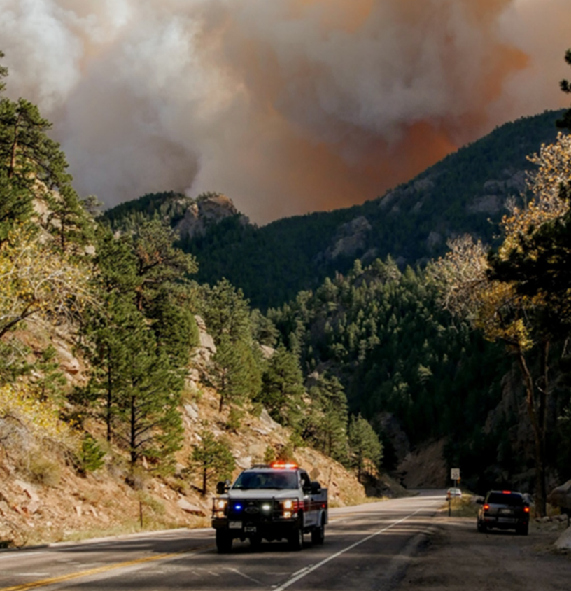
Level of Effort
Lower effort: Roadway capacity analysis compared to vehicles likely to evacuate
Medium effort: Roadway capacity analysis plus Origin-Destination analysis to identify evacuation distances and multi-hazard interactions
Higher effort: Modeled analysis of evacuation scenario(s) using Dynamic Traffic Assignment (DTA) evacuation module
If you anticipate a congested network with bottlenecks during the evacuation, particularly if they may affect route choice, use a simulation or Dynamic Traffic Assignment (DTA) Model to estimate ETEs
Photo Credit: kernvalleysun.com

Slide 15
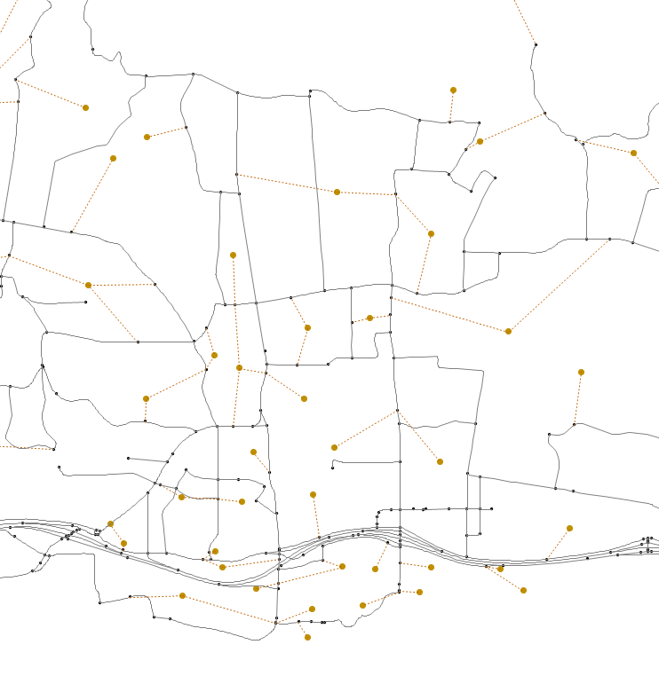
EVAC+ Subarea Model
Start with travel demand model.
Refine model network and land use data:
Isolate a geographic subarea from the model
Split Transportation Analysis Zones (TAZs)
Update socio-economic data
Refine and correct roadway network details, capacity assumptions, and speeds
Calibrate the model to reflect baseline conditions
Consider future roadway network modifications
Consider future land use growth
Notes:
Calibration: Review daily “typical” congestion
Review empirical count data (hour by hour, and average)
Run and iterate model baseline “no evacuation” scenario, making refinements to match
Reduce arterial capacity and free-flow speed
Increase trip generation/trip table
Adjust how volumes load on to the network to reflect school conditions
Adjust capacity/speed on certain roadways to model school-related friction (e.g., the congestion is school traffic, and also created by the school traffic)
Ensure new zone structure and network produces consistent calibration results

Slide 16
EVAC+ Process
Define evacuation scenario
Estimate trips during event (productions & attractions)
Distribute trips according to evacuation demand curve
Assign trips to roadway network to see how congestion accumulates
Evacuation time estimates
Notes:
Subarea is the base of the model – informs everything that happens in the background
We define what zones will evacuate and when. Trips from those zones will be loaded onto the network during the evacuation period.
Regular trips to and from those TAZs will stop once the evacuation period commences.

Slide 17
1. Define Evacuation Scenario
Scenario 1
Scenario 2
Phase 1
Phase 1
Phase 2
Phase 2

Slide 18
1. Define Evacuation Scenario
Network Considerations
Modify network to reflect desired conditions
Road closures
Contraflow/additional evacuation capacity
Modify network to account for reduced evacuation network capacity as relevant (e.g., effect of smoke and atypical driver behavior during wildfire/hazard event)
Consider extracting total evacuation times when 90% and 100% of population are evacuated
Notes:
Accounting for reduced network capacity during an event—people are human
Extracting total evacuation times for 90-100% evacuation

Slide 19
2. Estimate Trips
Vehicle Demand Considerations
Forecast evacuation vehicle trips for community population groups and project population groups (residents, employees, and/or visitors)
Estimate population of each group at time of evacuation notice(s)
Travel Demand Models: Built to estimate weekday daily and peak hour demands for normal trip purposes
Residential Evacuation Trip Demand: Varies based on household persons/vehicles/income levels (1.89 Veh/HH, UCB survey, 2017-19 fires)
Temporal Distribution (i.e., Evacuation Trip Time Distribution Curves): Varies by population group, shortest for employees/visitors, longest for residents
Notes:
Forecasting by groups for greater clarity (e.g., residents, employees, visitors)
Estimating populations at the time of evacuation notice(s)
Travel demand models are designed for normal trip purposes
Residential evacuation trip demand varies demographically
Location plays a big role in trip times for different groups
Background traffic makes a difference on through routes

Slide 20
2. Estimate Trips
Parameters | Scenario 1 | Scenario 2 | Change
Scenario Description | Phased evacuation of Zones 1, 2, 3, 8, 9, 10, 15, 16 | Phased evacuation of Zones 1, 2, 3, 8, 9, 10
Time of Day | 3:00-4:30pm | 3:00-4:30pm
Population | 3,787 | 2,248 | -1,539
Households | 1,123 | 517 | -606
Employees | 569 | 522 | -47
College Students | 745 | 745 | 0
Evacuation Trips | 3,200 | 2,085 | -1,115
Trip Distribution | 92% of trips sent E/W beyond the model area Of these, 40% east, 60% west 95% on US-101; 4% on SR-192; 1% by other arterials 8% internal to the model area All of these sent towards Santa Barbara, mostly to beach-front hotels
Notes:
Number of evacuating trips is an output

Slide 21
3. Distribution of Trips
Evacuation Time Distribution Assumptions
Share of Trips Ending in Different Evacuation Destinations
Description | Share of Trips | Details
Hotels | 8% | Based on a review of hotel capacity in the subarea
Shelters/Stadiums | 0% | No shelters or stadiums in the subarea
East | 36.8% | 95% on US-101 Southbound 4% on SR-192 1% on other E/W arterials
West | 55.2% | 95% on US-101 Northbound 4% on SR-192 1% on other E/W arterials
North | 0% | No trips evacuating North
South | 0% | No trips evacuating South
Time Interval | Phase 1 | Phase 2
3:00-3:14 | 100% | 2%
3:15-3:29 | 0% | 8%
3:30-3:44 | 0% | 21%
3:45-3:59 | 0% | 31%
4:00-4:14 | 0% | 18%
4:15-4:30 | 0% | 20%

Slide 22
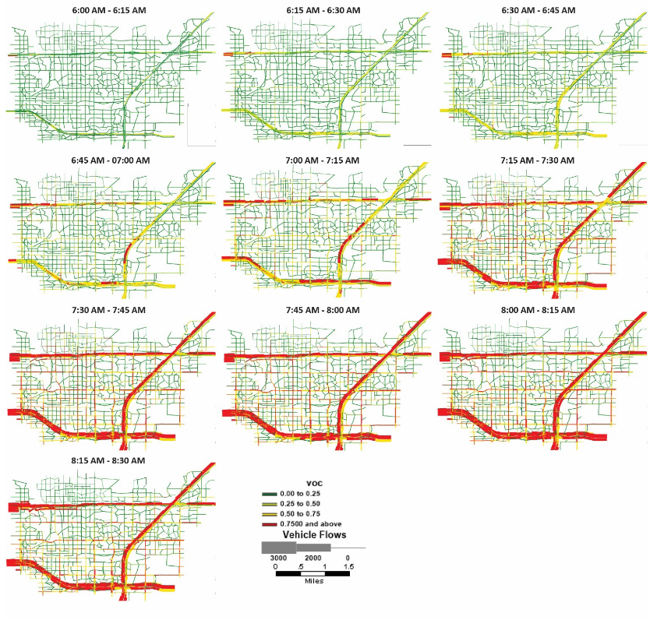
4. Assign Trips
Dynamic Traffic Assignment (DTA) Evacuation Module
Accounts for background traffic on any through routes from Subarea Model
Considers Evacuation Trip Productions and Attractions
Considers evacuation-specific distribution patterns (informed by big data or other data sources)
Inputs Evacuation OD Vehicle Trip Table into DTA Framework
Considers integration of Evacuation Transit Plan
Dynamic assignment in 15-minute increments

Slide 23
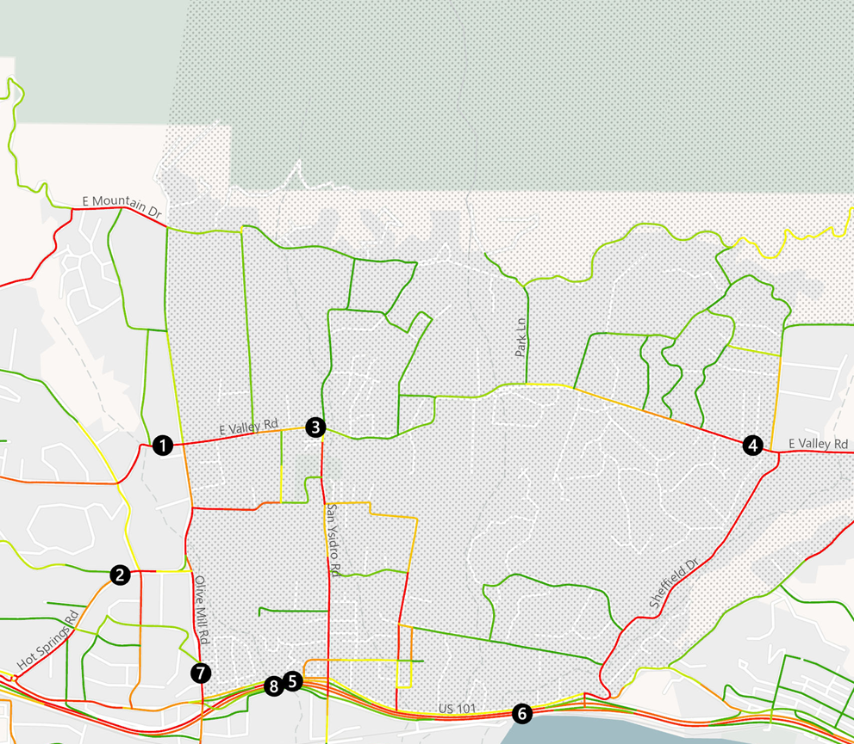
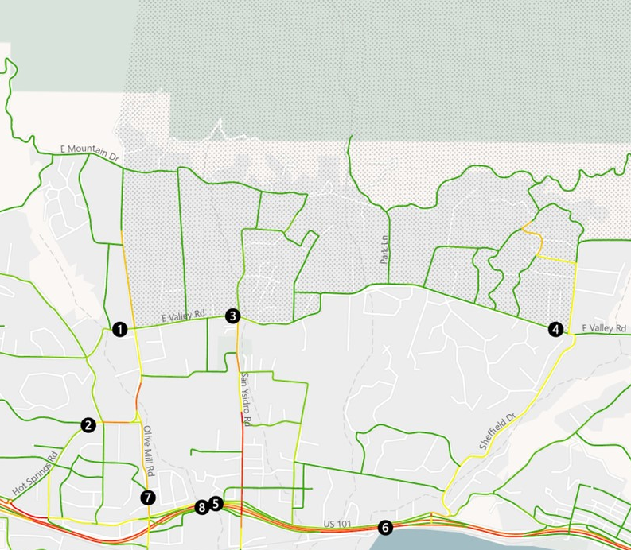
4. Assignment: Congestion per 15-minutes
Post Phase 1/Mid Phase 2
Volume/Capacity:
0.0 - 0.10
0.11 - 0.20
0.21 - 0.30
0.31 - 0.40
0.41 - 0.50
0.51 - 0.60
0.61 - 0.70
0.71 - 0.80
0.81 - 0.90
0.91 - 1.00
> 1.00

Slide 24
4. Assignment of Trips
Scenario 1
Scenario 2
Notes:
Sycamore Canyon south of Stanwood
Smaller peak in evacuation traffic but longer period of higher-than-normal traffic
Barker Pass Road serves as an additional route for evacuation traffic

Slide 25
5. Evacuation Time Estimates (ETEs)
“Clock” starts when a hazard is first identified
 | 0 | 5 | 10 | 20 | 25 | 30 | 35 | 40 | 45 | …
Hazard Detection Time when hazard is first identified
Hazard Notification to the Public Time when any official releases an evacuation order
Evacuation Order Received Time when people receive the evacuation order
Preparation Time to prepare to depart after receiving evacuation order
Travel Elapsed time from evacuation order until last vehicle clears evacuation area includes time moving and delay due to congestion
Preparation & Travel Time
Notes:
An evacuation time estimate (ETE) is a metric that is used to identify the time it takes for a selected population to evacuate a hazardous area due to an emergency.

Slide 26
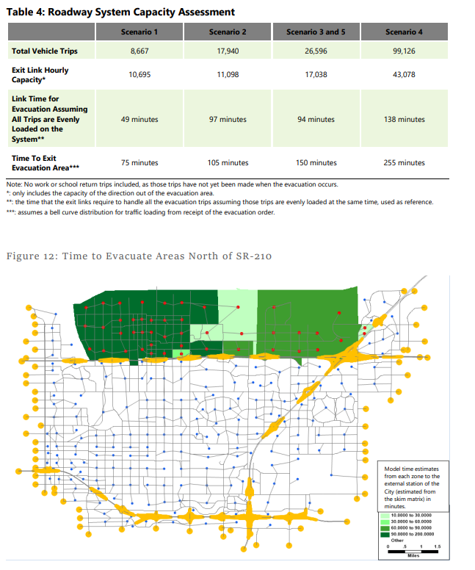
5. Evacuation Time Estimates

Slide 27
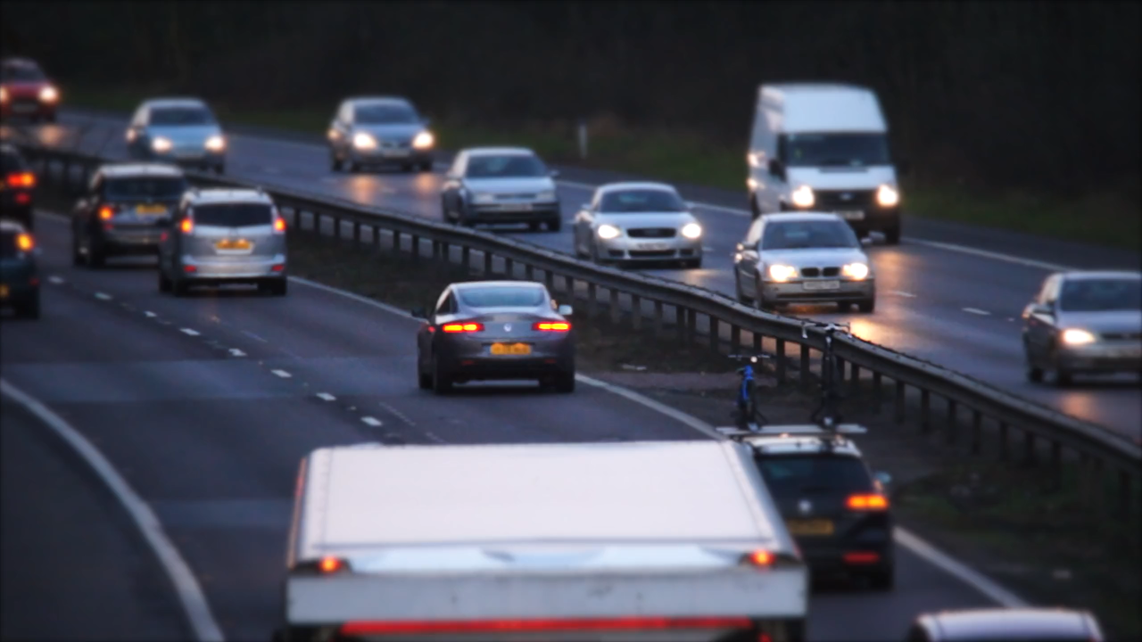
Drawing Conclusions

Slide 28
Testing and Determining Strategies to Reduce ETEs
Demand-Side: Timely departures, phased evacuation, triggered evacuations, vehicle reduction, hardened shelters
Supply-Side: Shoulder usage, ramp closures, route closures, turn restrictions, signal priorities, manual traffic control, public transit, mode shift, parking restrictions
Information-Side: Early Hazard detection systems, rapid information delivery, evacuation preparation, route preparation, dynamic route guidance, system monitoring, travel information
Notes:
Demand-Side
Timely departures, strategies to reduce last-minute evacuation/rapid loading of the road network, releasing evacuees by pre-designated zone, orders based on characteristics of the hazard, such as fire spread characteristics and capacity of evacuation routes, take only one or two vehicles
Supply-Side
Contraflow, Shoulder usage, Ramp closures to reduce bottlenecks, Route closures to reduce vehicle movements into the hazardous, Restricting turning at an intersection to increase flow, Setting traffic signals to prioritize certain traffic movements Providing backup power to traffic signals to maintain function if electrical grid fails during emergency event, Manual traffic control to prioritize evacuating vehicles, Using high-capacity public transit vehicles to reduce the use of single-occupancy vehicles, Mode shift such as carpooling, shared mobility, cycling, or walking, Parking restrictions to reduce pinch points and increase flow of vehicles
Information-Side
Advance wildfire detection systems (i.e., wildfire sensors, cameras, drones), Rapid information delivery - Reducing the notification time between hazard detection and the issuance of mandatory evacuation orders by obtaining and transmitting information quickly and making informed, quick decisions, Encouraging residents to prepare for an evacuation, such as making a household evacuation plan or making a go-bag with essential documents and emergency supplies, Presenting possible route options for evacuees in advance of disasters through educational campaigns or physical infrastructure (e.g., evacuation signs), Providing evacuees with guidance on safe and efficient routes along with dynamic rerouting information to decrease travel times and reduce congestion on highly-traveled roads (can include GPS-routing systems), Monitoring traffic using intelligent transportation system (ITS) technology to identify accidents and problem areas, determine the effectiveness of responses, and change responses as needed, Communicating traffic and service information to evacuees before and during the evacuation to convey shelter locations, alternate evacuation routes, congestion alerts, and location of services
Infrastructure
In addition to these response strategies, infrastructure changes such as roadway widenings to eliminate bottlenecks may be beneficial in reducing evacuation times. However, due to the cost of construction and sustainability issues that could arise, this option is generally not recommended. In lieu of roadway expansion, jurisdictions could also consider flexible infrastructure (as noted in several supply-side strategies) (e.g., shoulder lane widening to provide joint evacuation lane/separated bike lane) that temporarily increase roadway capacity during an evacuation.

Slide 29
Toolbox of Evacuation Strategies
Planning
Programs
Projects
Multi-Jurisdiction Evacuation Routes Map
Focused Evacuation Plans for High Congestion Areas
Contraflow Operations Plan
Freeway Ramp Closure Plan (Caltrans)
Multi-Agency Evacuation Coordination Plans
Resilience Hub/Facility Hardening
Evacuation Plans for Schools And Senior Care Facilities
Phased Evacuation Feasibility Assessment
Evacuation Scenario Assessments
Community Evacuation Education
Evacuation Route Roadside Fuel Break Program
Narrow Street Parking Management Plan (High Hazard Days)
Early Notification System for Parcel Clusters with Single Egress Route
Evacuation Intersection Traffic Management
Vehicle Crash Emergency Clearance Crews
Transit Agency Evacuation Support
Evacuation Vehicle Demand Reduction Program
Intersection Traffic Control Improvements
Directional Road Lane Widening
Dual Purpose Shoulder Evacuation/Protected Bike Lane Widening (Egress Only)
Fire Road Enhancements for Emergency Vehicle Access
Second Egress Routes for Constrained Parcel Groups
Evacuation Wayfinding, Signs, And Barriers
Dynamic Route Guidance and Monitoring System
Hazard/Wildfire Early Detection Systems (Cameras, Drones)
Communication System Hardening

Slide 30
Additional Planning Considerations
Equity
Vulnerability
Policy Response
Who is affected when areas of the jurisdiction lose access in an emergency?
Race/ethnicity
Income
Age
Gender
Employment sector
Who might have a harder time evacuating?
Vehicle ownership
Household size
Disability status
Pets/animals
Linguistic isolation
Hospitals, schools, prisons, group homes, tourists
How does the jurisdiction intend to use the information revealed through the evacuation analysis?
Inter-agency coordination
Land use decisions
Transportation operations plans, infrastructure, state of good repair
Notes:
Consider changing “linguistic” to “language” in column 2.

Slide 31
THANK YOU
a.scher@fehrandpeers.com

Slide 32
Wildfire Preparedness: Artificial Intelligence and Modeling in Wildfire Evacuation Planning
Bowen Kyle, Ladris CTO
Leveraging AI Technology for
Safe, Accurate and Efficient Evacuations
3

Slide 33
Evacuations: No Longer a Rarity
Evacuations of 1,000 or more people occur approximately every two to three weeks in the US
Sandia National Laboratories
75% of these events involve small-scale evacuations of fewer than 5,000 individuals
Sandia National Laboratories
Disasters displaced more than 3 million Americans in 2022
Census Bureau
Evacuations can happen anywhere, anytime

Slide 34
Introduction to AI in Evacuation Planning
What is AI?
Artificial Intelligence (AI) is a field of study and technology development focused on building machines and systems capable of performing tasks that typically require human intelligence. These tasks include learning from data, recognizing patterns, making decisions, and understanding natural language.
Source: National Artificial Intelligence Initiative Office (NAIIO)
How can AI be Applied to Evacuation Planning
AI is a force multiplier enabling the ability to think about multiple scenarios in emergency situations and use predictive modeling.
AI is not meant to be a substitute for the expertise of emergency managers.

Slide 35
How AI Transforms Evacuation Planning
AI-Based Software
01
Real-Time
02
Unlimited Number of Simulations
03
Multiple Data Sources
04
Proprietary AI Software
05
Unrestricted Execution; Use Remotely
06
Force Multiplier

Slide 36
An AI Evacuation Tool Provides Answers to Two Fundamental Problems
Who Needs To Be Evacuated?
Where Should They Be Evacuated To?

Slide 37
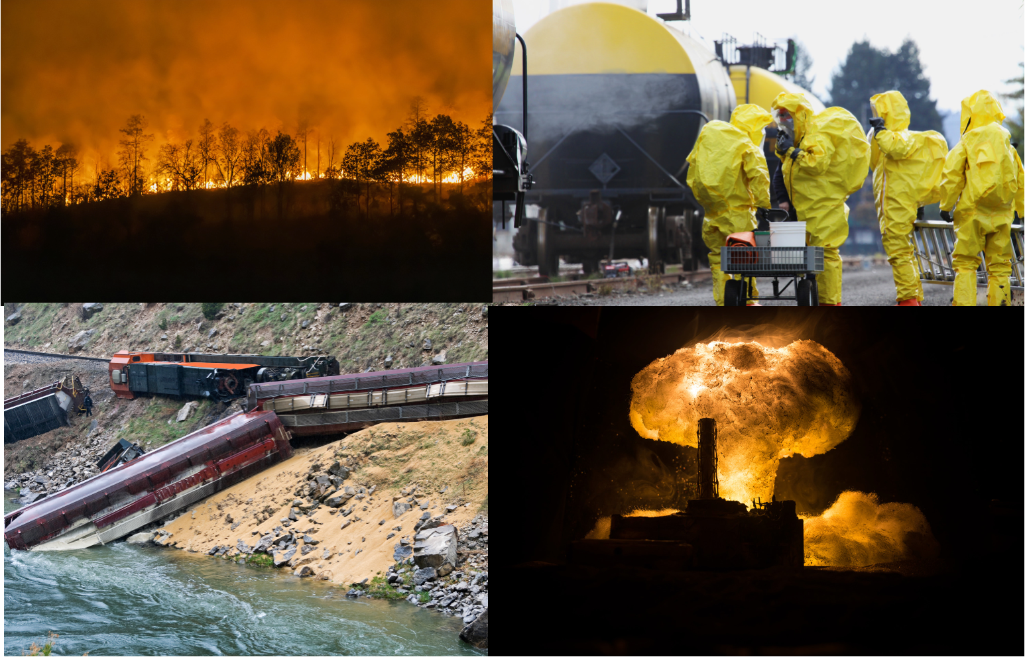
Attributes of an AI-Enabled Evacuation Tool
Easy to Use
Intuitive Dashboard
Intelligent Insights
Powerful Visualizations
Detailed Analysis
Run 1, 100 or 1000 Scenarios
Simulation Feedback in Seconds
Supports Public Engagement
Accurate

Slide 38
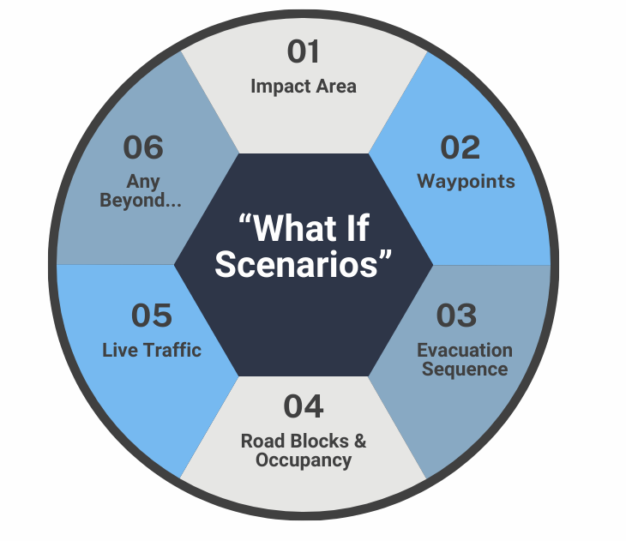
AI Results Using Six Inputs

Slide 39
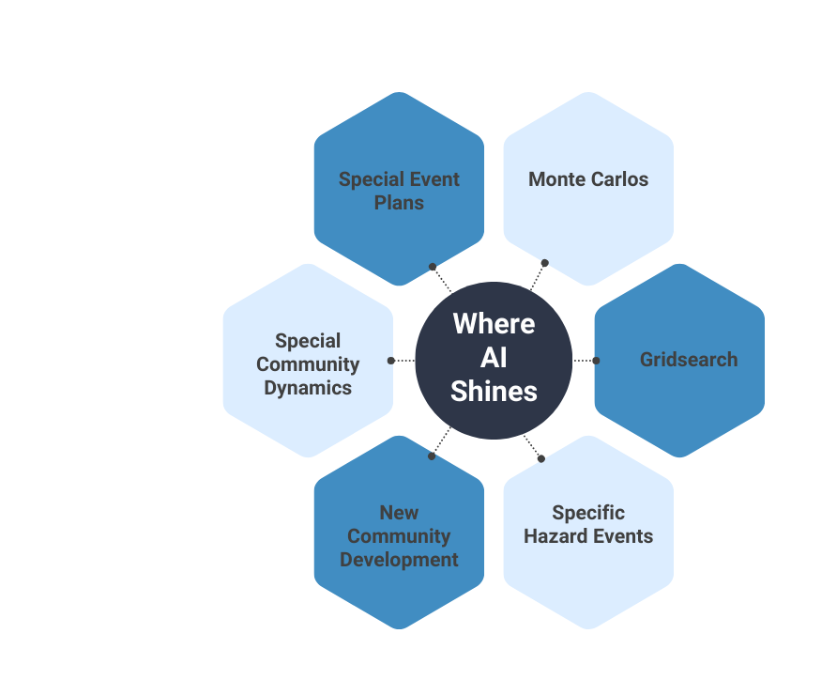

Slide 40
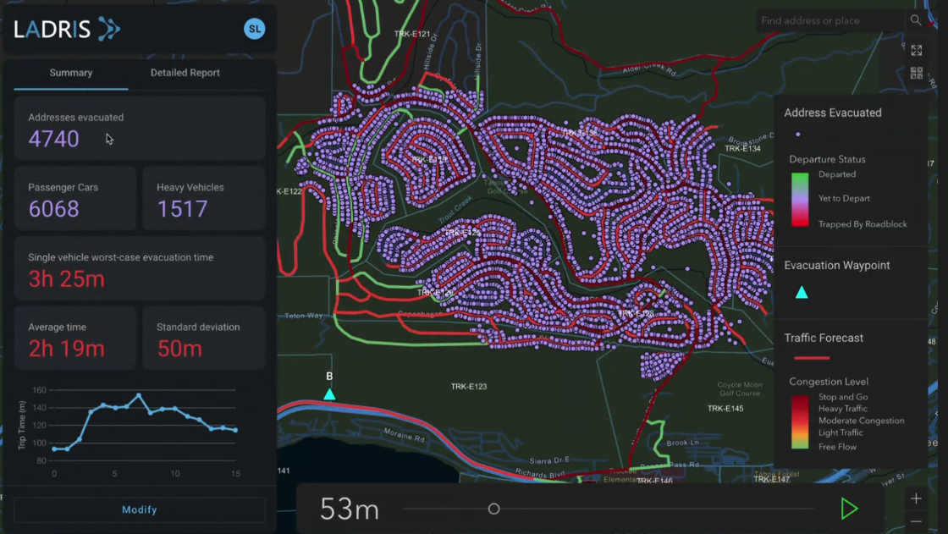
AI-Driven Key Metrics
Quantitative
Number of Addresses Evacuated
Number of Passenger Cars
Number of Heavy Vehicles
Single Vehicle Worst-Case Evacuation Time
Average Vehicle Time
Standard Deviation
Visual
Representation of How Evacuation Could Work - Individuals Leaving Addresses
Witness the Congestion on the Roads Forming and Dissolving

Slide 41
AI-Enabled Predictive
Modeling Demo

Slide 42
Thank You!
American Planning Association State Conference
September 30, 2024

